Slide 1
A CLINICAL APPROACH ON SPINE DISEASES WITH PANCHAKARMA TREATMENTS
BY
PROF(Dr.)DIPAK SWAIN
M.D(AY). Ph.D

Slide 2
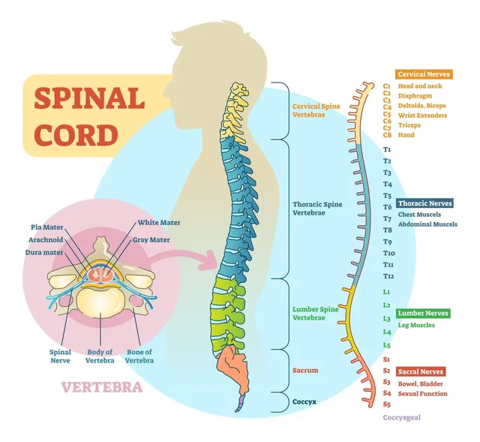
Spinal cord

Slide 3
A CLINICAL APPROACH ON SPINE DISEASES WITH PANCHAKARMA TREATMENTS
INTRODUCTION
SPINE DISEASES
Life style diseases,
early degenerative diseases,
non communicable diseases,
Sedentary lifestyles may leads to some compressive or degenerative changes to spine, disc, spinal cord, spinal canal, nerve roots or other structural and functional abnormalities or serious complications like paralysis and permanent disabilities.

Slide 4
A CLINICAL APPROACH ON SPINE DISEASES WITH PANCHAKARMA TREATMENTS INTRODUCTION
Conditions may be
Lordosis (inward at LB), kyphosis rounded at upper back, scoliosis : sideways curve to spine
Spondylosis : cervical or lumber : degenerative changes to spine modified with osteophytic changes
Disc Herniation, Bulging: protrusion: prolapse: tear: compression: displace: degeneration: rupture..
Spinal canal narrowing or spinal canal stenosis.
Nerve root compression.

Slide 5
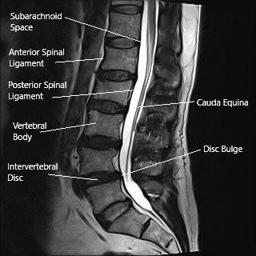

Slide 6
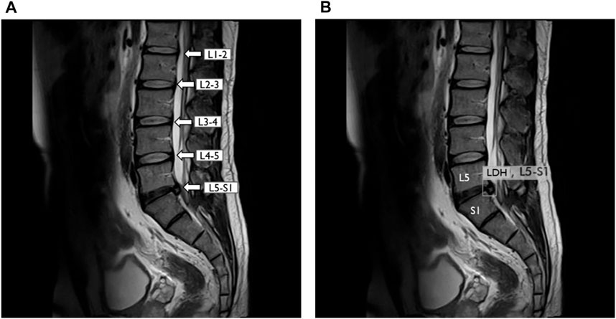

Slide 7
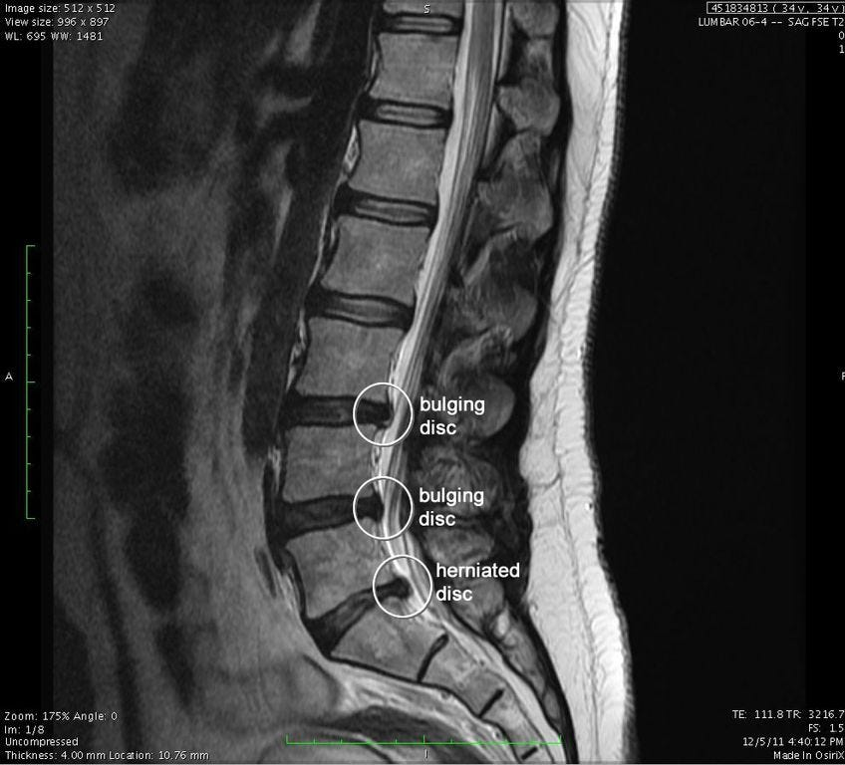

Slide 8
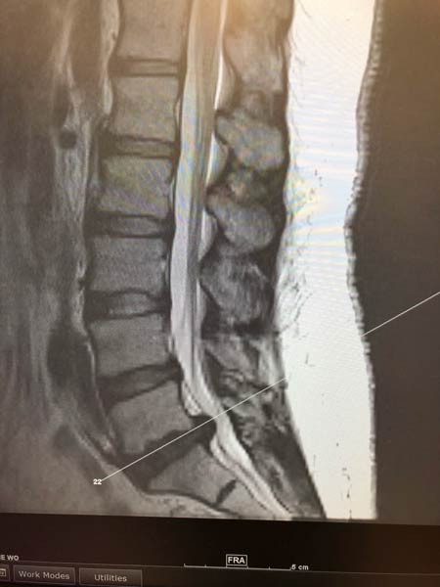

Slide 9
A CLINICAL APPROACH ON SPINE DISEASES WITH PANCHAKARMA TREATMENTS INTRODUCTION
Four stages of degenerative disc disease
Dysfuction stage 1
Dehydration stage 2
Stabilization stage 3
Collapsing stage 4

Slide 10
A CLINICAL APPROACH ON SPINE DISEASES WITH PANCHAKARMA TREATMENTS INTRODUCTION
Global spine journal published in April 24, 2018
Incidence and prevalence
3.63% DSD and LBP -266 million
Spondylolisthesis 0.53%-39million (vertebra slips forward)
Disc degeneration 5.5% -403 million
Spinal stenosis 1.41% - 103 million

Slide 11
A CLINICAL APPROACH ON SPINE DISEASES WITH PANCHAKARMA TREATMENTS INTRODUCTION
Oral medications ; vata samaka medicines
Panchakarma : a systematic approach to spine conditions
lepa
Pitchu spinal area
Kati vasti
Massage
Swedana
Nasya
Exercise: self silent exercise
For a period of treatment of one month to six month

Slide 12
A CLINICAL APPROACH ON SPINE DISEASES WITH PANCHAKARMA TREATMENTS INTRODUCTION
Clinical manifestations
Pain, tenderness, stiffness, numbness on neck, back, legs and hands.
Restricted forward and backward movements.
Pain aggravates on constant sitting, riding, driving, mobile and laptop operating (table jobs)
Pain aggravates cold air, cold water, heavy exercise, weight lifting, or constant pressure on spine.
Some times pain aggravates in all positions and postures.
Clinical conditions progressively develops to paralysis or physical disability for life time.

Slide 13
A CLINICAL APPROACH ON SPINE DISEASES WITH PANCHAKARMA TREATMENTS INTRODUCTION
Diagnosis based on MRI findings

Slide 14
A CLINICAL APPROACH ON SPINE DISEASES WITH PANCHAKARMA TREATMENTS RESEARCH METHODOLOGY
RESEARCH METHODOLOGY
Clinical study was done on 100 patients in two groups A and B in GAM, Puri and Ayushree Health care at Bhubaneswar. Each group having 50 patients for period of one year from 2022 to 2023 both in OPD and IPD levels. Group A is the medicine with panchakarma treatment group and Group B is the medicinal treatment group.
Inclusion criteria : includes patients having MRI based diagnosis spine complains.
Exclusion criteria: infective spine diseases, ca spine, tumour on spine, post surgical spine, accidental spine changes, conditions those are not supportive for panchakarma treatments.

Slide 15
A CLINICAL APPROACH ON SPINE DISEASES WITH PANCHAKARMA TREATMENTS RESEARCH METHODOLOGY
STUDY: Randomised controlled trial
STUDY DESIGN
Group A
BT Vs AT Effectiveness study
Group B
BT Vs AT Effectiveness study
Group A Vs Group B Efficacy study
PLAN OF STUDY: In group A both the treatments are given (oral medications with panchakarma treatment). In group B only oral medications.

Slide 16
SCHEDULED TREATMENTS
Oral medications
Panchakarma :a systematic approach to spine conditions
lepa- Awagandha gomootra lepa
Pitchu spinal area -30 minutes
Kati vasti and griva vasti -30 minutes
Massage – 10 minutes
Swedana – 5 minutes CPS /PPS
Nasya -8 -16 drops/ day in both nostrils
For a session of one hour 30 minutes/day
Exercise: self silent exercise
For a period of treatment of one month to six month

Slide 17
A CLINICAL APPROACH ON SPINE DISEASES WITH PANCHAKARMA TREATMENTS RESEARCH METHODOLOGY
Assessment done by objective parameters
Spine changes
Disc changes
Spinal cord changes
Spinal nerve changes
Myelopathic changes

Slide 18
A CLINICAL APPROACH ON SPINE DISEASES WITH PANCHAKARMA TREATMENTS RESEARCH METHODOLOGY
Statistical measurement is made by
Mean
Median
Mode
Deviation
Standard deviation
Standard error
Student t test
Probability assessment

Slide 19
A CLINICAL APPROACH ON SPINE DISEASES WITH PANCHAKARMA TREATMENTS RESEARCH METHODOLOGY
IVDS disc degeneration : Pfirrmann grading scale
Grade -1 – normal disc
Grade -2- an inhomogeneous disc with normal disc height and annulus
Grade -3- an inhomogeneous gray disc with a loss of the clear border between the nucleus and annulus and normal to slightly decreased disc height
Grade-4- an inhomogeneous hypo intense dark gray disc with significant disc height loss.
Grade -5- a inhomogeneous black disc with disc space collapse,

Slide 20
A CLINICAL APPROACH ON SPINE DISEASES WITH PANCHAKARMA TREATMENTS RESEARCH METHODOLOGY
The classification of Pfirrmann disc degeneration grade
Grade 1- Homogeneous, bright white Clear Hyperintense, isointense to cerebrospinal fluid Normal
Grade 2- Inhomogeneous with or without horizontal bands Clear Hyperintense, isointense to cerebrospinal fluid Normal
Grade 3 - Inhomogeneous, gray Unclear Intermediate Normal to slightly decreased
Grade 4 - Inhomogeneous, gray to black Lost Intermediate to hypointense Normal to moderately decreased
Grade 5 - Inhomogeneous, black Lost Hypointense Collapsed

Slide 21
A CLINICAL APPROACH ON SPINE DISEASES WITH PANCHAKARMA TREATMENTS RESEARCH METHODOLOGY
Grade 1, normal shape, no horizontal bands, clear distinction of nucleus and annulus;
grade 2, nonhomogeneous shape with horizontal bands, some blurring between nucleus and annulus;
grade 3, nonhomogeneous shape with blurring between nucleus and annulus, annulus shape still recognizable;
grade 4, nonhomogeneous shape with hypointensity, annulus shape not intact and distinction between nucleus and annulus impossible, disc height usually decreased;
grade 5, same as grade 4 but with collapsed disc space.

Slide 22
A CLINICAL APPROACH ON SPINE DISEASES WITH PANCHAKARMA TREATMENTS RESEARCH METHODOLOGY
DISC BULGE;
A bulge of 7 millimeters +, is considered severe.
When the jelly starts displacing backwards, it causes the outer covering to bulge out and it may put pressure on the nerve roots at that level.
If the bulge is at L4- L5 or L5 –S1, it may cause pressure on the sciatic nerve.
HERNIATED DISC :Four stages
Stage -1-disc compression -bulging
Stage-2- bulging disc – disc protrusion
Stage -3- disc protrusion- disc extrusion
Stage -4- herniated disc – disc sequestration

Slide 23
A CLINICAL APPROACH ON SPINE DISEASES WITH PANCHAKARMA TREATMENTS RESEARCH METHODOLOGY
GRADES OF RADICULOPATHY
Mild : sensory loss and pain without motor deficit
Moderate : sensory loss or pain with mild motor deficit
Severe : sensory loss or pain with marked motor deficit

Slide 24
A CLINICAL APPROACH ON SPINE DISEASES WITH PANCHAKARMA TREATMENTS RESEARCH METHODOLOGY
NURIC GRADES ; Nerve root involvement
- signs and symptoms of root involvement but without evidence of spinal cord disease.
- signs of spinal cord disease but no difficulty in walking.
-slight difficulty in walking which didn’t prevent full time employment.
- difficulty in walking which prevented fulltime employment or the ability to do house work but which was not so severe as to require someone elses’s help to walk
- able to walk only with someone else’s help or with the aid of frame
-chair bound or bedridden.

Slide 25
A CLINICAL APPROACH ON SPINE DISEASES WITH PANCHAKARMA TREATMENTS RESEARCH METHODOLOGY
RESULTS
In group A maximum improvement is 80%, moderate improvement is 12%, mild improvement 7%, unsatisfactory 1%, after 6 months of treatment.
In group B maximum improvement is 10% for a certain period, moderate improvement 12%, mild improvement 7%, unsatisfactory 71% after 6month of treatment.

Slide 26
A CLINICAL APPROACH ON SPINE DISEASES WITH PANCHAKARMA TREATMENTS RESEARCH METHODOLOGY
RESULTS
A total no of 196 patients axial T2 W MRIs in 100 patients in the internal data sets were evaluated. Over all the mean age of all patients was 50±15, age range 20 -65 years. Both the sexes are equally distributed.
After 3weeks to 8 weeks of treatment, (AT1) myelopathic and radiological changes to spine the pain, tenderness, stiffness with test of significance Mean±SD is equal to 10 ± 2.025 with p value ≤0.001, highly significant. in panchakarma and medicinal treatments in group A.
After 8weeks to16 weeks of treatment,(AT2) medicinal treatment with panchakarma abhyanga progressive development in forward bending, backward bending, strength in legs for long walk upto 3 km, with reducing symptoms like numbness, tingling sensation means abnormal disc changes.

Slide 27
A CLINICAL APPROACH ON SPINE DISEASES WITH PANCHAKARMA TREATMENTS RESEARCH METHODOLOGY
with test of significance Mean±SD is equal to 10 ± 2.025 with p value ≤0.001, highly significant. Both panchakarma and medicinal treatments in group A.
After 17 -24 weeks of treatment patient lives with normal life
With progressive changes to MRI reports to degenerative changes to spine, osteophytic changes to spine, disc herniation changes, radiculopathy changes, myelopathy changes except spinal cord and spinal canal changes. with test of significance Mean±SD is equal to 10 ± 2.025 with p value ≤0.001, highly significant. Both panchakarma and medicinal treatments in group A.
For this it requires another 6 month oil application ( abhyanga).

Slide 28
A CLINICAL APPROACH ON SPINE DISEASES WITH PANCHAKARMA TREATMENTS RESEARCH METHODOLOGY
In group B there is some changes in radiculopathy and myelopathy with Mean±SD is 9±2.025 with t value 4.653 and p value ≤0.001 highly significant in initial two months of treatment but p value ≥ 0.05 indicates insignificant means no change in degenerative change, disc change and spinal canal change even after 4monthsand 6 months of treatment.
In between Group A and Group B, group A is highly significant with p value ≤0.001 in AT1,AT2 and AT3

Slide 29
A CLINICAL APPROACH ON SPINE DISEASES WITH PANCHAKARMA TREATMENTS RESEARCH METHODOLOGY
Clinical evaluation

Slide 30
A CLINICAL APPROACH ON SPINE DISEASES WITH PANCHAKARMA TREATMENTS RESEARCH METHODOLOGY
Conclusion
After 6 months of scheduled treatment patient regains his /her normal life activity.
Free from functional disability

Slide 31
…………………………………………………..
THANKS YOU

