Slide 1
AMLAPITTA
Definition of Amlapitta
Amlapitta is composed of two words Amla+ Pitta. Also it is said that Amla has been a natural property of pitta along with Katurasa
Susruta has enlisted Katu as its original ras and mentioned that when Pitta becomes vidagdha changes into Amla .
The augmented or increased Amla guna of pitta is known as Amlapitta .
The pitta which attains amla guna and vidagdhata is called as Amlapitta

Slide 2
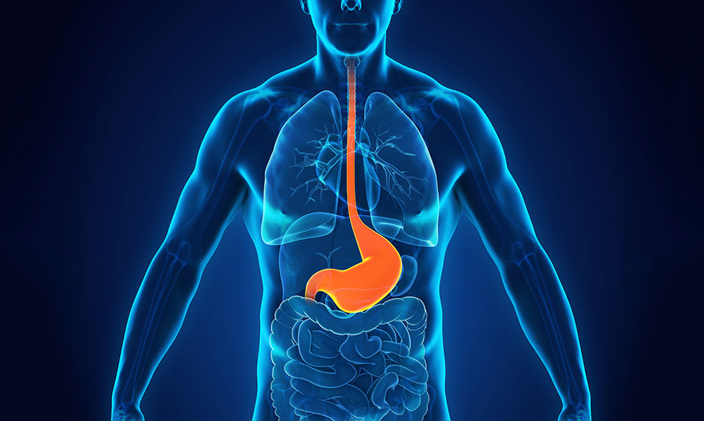

Slide 3
AMLAPITTA
Virudha- Desa, kala, agni, matra, satmya, vatadi dosa, samskar, virya, kostha, avastha, krama, parihara, upachara, paka, samyoga, hridaya, sampat, vidhi.
Dustaamla-
Vidahi –
Pitta prakopi panannabhujou vidagdham
Pittam swahetupachitam

Slide 4
AMLAPITTA
Nidan of Amlapitta
Aharaj nidan : Virudhasana, ajirna, ame purnat, pishtanna, ama apakva madya, goras atisevan, guru bhojan, abhishyandi bhojan, ushnatisevan, snigdhatisevan, rukshatisevan, amlatisevan, drava- tisevan, fanit sevan, ikshu vikar, kultha sevan, bhrisht dhanya, pulak, prithuk sevan.

Slide 5
AMLAPITTA
Mansik nidan-
Acharya charak mentioned that even the
wholesome food also taken in proper qauantity, does not get digested due to anxiety, grief, fear, anger, uncomfortable bed and vigil. It produces ama and that cause Amlapitta.
Considering the samprapti of Amlapitta, it can be assessed that administration of “Tikta rasa” pradhana dravyas
alleviates the disease. Ayurvedic Classics have indicated several single drugs in the treatment of Amlapitta

Slide 6
AMLAPITTA
Samanya lakshan
Avipaka
Klama
Utklesh
Tikta udgar
Amlaudgar
Gaurav
Hrid dah
Kanth dah
Aruchi

Slide 7
AMLAPITTA
Chikitsa of amlapitta
According to Acharya Charak chikitsa of all disease can be
devided in 3 part-
1. Nidan parivarjan 2. Samshodhana 3. Shamana

Slide 8
AMLAPITTA
Classification of Amlapitta
1. Madhavkara classified Amlapitta in two ways-
A) According to pravritti
Urdhavaga
Adhoga
B) According to Dosha
Vataja
Vata –kaphaja
Kaphaja

Slide 9
AMLAPITTA
Kashyapa described this disease into three types according to prominent of Dosha
Vataja
Pittaja
Kaphaja
According to Gatibheda it is divided into two categories.
1. Urdhwaga 2. Adhoga
According to Doshas it is divided into three categories.
1. Saanila 2. Sakapha 3. Saanilakapha

Slide 10
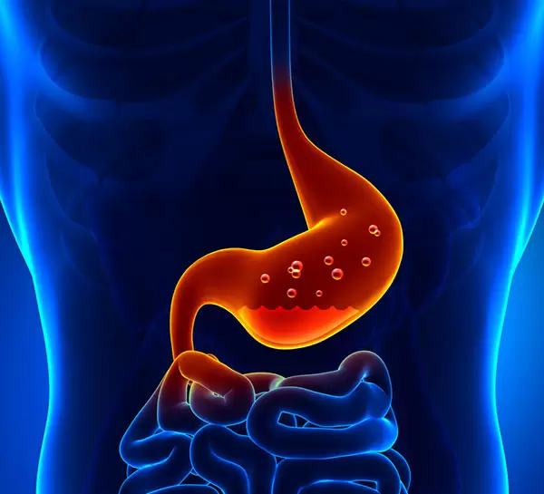

Slide 11
AMLAPITTA
Acid peptic disorders
Acid peptic disorders include a number of diseases, whose etiology can be linked to gastric secretions.
Gastro esophageal reflux disease, and peptic ulcer disease, are two most common and well- defined disease states.

Slide 12
AMLAPITTA
GERD is defined as chronic symptoms or mucosal damage
produced by the abnormal reflux of gastric contents into the esophagus.
Reflux esophagitis refers to a subgroup of GERD patients with histopathologically demonstrated characteristic changes in the esophageal mucosa.
Non erosive reflux disease, also known as endoscopy negative reflux disease, refers to patients with typical GERD symptoms caused by intra-esophageal acid who do not have visible mucosal injury at endoscopy.

Slide 13
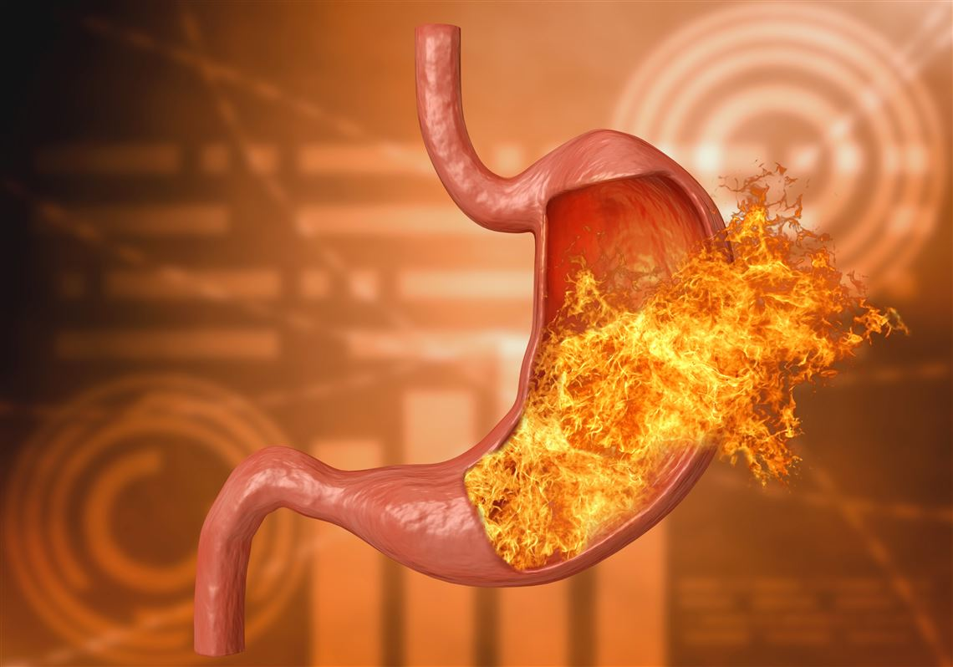

Slide 14
AMLAPITTA
Prevalence
Heartburn is a common problem in the United states and in the western world
since many individuals control symptoms with over-the counter medications and without consulting a physician, the condition is likely under reported.
Approximately 7% of the population experience symptoms of heartburn daily.
20-40% of the people who experience heartburn do indeed have GERD.
No sexual prediction exists. GERD is common in men as well as in women.
GERD occurs in all age groups.
The prevalence of GERDS increases in people older than 40 years.

Slide 15
AMLAPITTA
Etiology
Lower esophageal sphincter incompetence.
Transient lower esophageal sphincter relaxation.
Hital hernia.
Obesity: contributing factor in GERD.

Slide 16
AMLAPITTA
Typical features
Heartburn
regurgitation

Slide 17
AMLAPITTA
Atypical features
Coughing /or wheezing
Hoarseness
Pneumonia
Belching
Laryngitis
Otitis media
Enamel decay

Slide 18
AMLAPITTA
Alarm Symptoms that, in Presence of GERD Symptoms, necessitate Immediate Endoscopy
Dysphagia
Odynophagia
Anorexia
Unintentional weight loss
Hematemesis/melena
Persistent vomiting

Slide 19
AMLAPITTA
Differentials
Achalasia
Cholelithiasis
Coronary artery atherosclerosis
Esophageal spasm
Esophageal cancer
Esophagitis
Chronic gastritis
Irritable bowel syndrome
Peptic ulcer disease

Slide 20
AMLAPITTA
Work Up
Barium esophagogram
Esophagogastrodudenoscopy
Esophageal manometry
Radionuclide measurement of gastric emptying
Ambulatory 24- hour pH monitoring
Empiric trial of proton pump inhibitor
Multichannel intraluminal impedance
Bravo system

Slide 21
AMLAPITTA
Esophagogastrodudenoscopy
Advantages
Enable visualization and biopsy of esophageal epithelium
Determine presence of esophagitis, other complications
Discrimination between reflux and non-refluxesophagitis
Limitations
Need for sedation or anasthesia
Endoscopic grading system not yet validated for pediatrics
Poor correlation between endoscopic appearance and histopathology
Generally not useful for extra esophageal GERD

Slide 22
AMLAPITTA
Multiple Intraluminal Electrical Impedance
Measurement
Advantages
Detects no nacidic GER episodes
Detects brief (<15 s) acidic GER episodes
Useful for studying respiratory symptoms and GER in infants
Limitations
Normal values in pediatric age groups not yet defined
Analysis of tracing time consumption
Not reliable for upper esophageal GER episodes

Slide 23
Esophageal pH monitoring
Advantages
Detects episode of reflux
Determine temporal association
between acid GERD and
symptoms
Determines effectiveness of
esophageal clearance mechanisms
Assesses adequacy of H2Ra or
PPI dosage in unresponsive patients
Limitations
Cannot detect non acidic
reflux
Cannot detect GERD
complications associated with
normal range of GER
Not useful in detecting
association between GERD
and apnoea unless combined
with other techniques.

Slide 24
AMLAPITTA
Medical treatment
Lifestyle modification
Losing weight (if over weight)
Avoiding alcohol, chocolate, citrus juice, and tomato-based products
Avoiding large meals
Waiting 3 hours after a meal before lying down
Elevating the head of the bed 8 inches

Slide 25
AMLAPITTA
Treatment cont….
Pharmacological therapy
Antacid
Prokinetic agents
H2 receptors antagonist
Proton pump inhibitors

Slide 26
AMLAPITTA
Treatment cont….
Antacid
Promt but temporary relief
No objective proof of superiority to pacebo
Prokinetic
Improvement of symptoms in mild GERD
Effective for healing only erosive esophagitis
Can be useful in a select patient popualation
H2RAs
Relief of symptoms in ~50% of patients
Effective for healing only mild erosive esophagitis

Slide 27
AMLAPITTA
Complications.
Esophagitis
Stricture
Barret esophagus
Adenocarcinoma
Respiratory complications

Slide 28
AMLAPITTA
Points to remember
Endoscopy reveals that 50% of patients do not have esophagitis.
The only way to determine if abnormal reflux is present and if symptoms are actually caused by GERD is through pH monitoring.
Achalasia can preset with heartburn. Only esophageal
manometry and pH monitoring can be used to distinguish achalasia form GERD.

Slide 29
AMLAPITTA
Peptic Ulcer Disease
Peptic ulcers are defect in the gastro-intestinal mucosa that extend through the muscularis mucosa.

Slide 30
AMLAPITTA
Prevalence
Lifetime prevalence is approximately 11-14% for men.
Lifetime prevalence is approximately 08-11% for women.
Age trend for ulcer occurrence reveal declining rates in younger
men, particularly for duodenal ulcer, and increasing rates in older
women.

Slide 31
AMLAPITTA
Etiology
Helicobacter pylori infection
Consumption of NSAIDS
Severe physiologic stress
Hypersecretory states

Slide 32
AMLAPITTA
Symptoms
Epigastric pain
Nausea
Vomiting
Dyspesia
Heartburn
Chest discomfort
Anorexia, weight loss
Hematemesis or melena

Slide 33
AMLAPITTA
Signs
Epigastric tenderness
Epigastric pain
Guaiac-positive stool
Succio0n splash

Slide 34
AMLAPITTA
Differentials
Biliary colic
Cholecystitis
Cholelithiasis
Gastritis, Acute
Gastritis, Chronic
Gastro-esophageal reflux disease
Mesenteric artery ischemia
Myocardial ischemia
Pancreatic cancer
Pancreatitis, Acute
Pancreatitis, Chronic

Slide 35
AMLAPITTA
Work up
Double contrast radiography
Detection of H pylori infection
Endoscopic test
Serum gastrin

Slide 36
AMLAPITTA
Medical treatment
H pylori eradication: Dual/triple therapy
Cessation of NSAIDs
H2 receptor antagonists
Proton pump inhibitors
Prostaglandins
Sucralfate

Slide 37
AMLAPITTA
FDA-Approved Treatment Regimes
for H pylori infection
Omeprazole 20 mg BID + Clarithromycin 500 mg BID +
Amoxicillin 1 g BID for 10 days
Lansoprazole 30 mg BID + Clarithromycin 500 mg BID +
Amoxicillin 1 g BID for 10 days
Bismuth subsalicylate (Pepto Bismol) 525 mg QID +
Metronidazole 250 mg QID + Tetracycline 500 mg QID * 14
days + H receptor antagonist * 4 weeks

Slide 38
AMLAPITTA
Complications
Haemorrhage
Confined perforation
Open perforation
Gastric outlet obstruction
Recurrence
Stomach cancer

Slide 39
AMLAPITTA
SL NO | Name of the medicine | Chief ingradiants | indication
01 | AVIPATTIKARA CHOORNA | Triphala, trikatu, mustha, bid lavana, bidanga, ela, patra, nisotha. sugar | Malamutra vivandha,agnimandya roga, prameha, arsa.
02 | LEELAVILAS RASA | Parada, gandhak, abhraka, tramra bhasma, louha bhasma, Amalaki, beheda, bhrungaraj swaras | Vamana, shula, hridaya dahakasta
03 | AMLAPITTANTAKA LAUHA | Rasa sindura, tamra bhasma, louha bhasma, haritaki choorna. | Amlapitta, shula.

Slide 40
AMLAPITTA
04. BHASKARAMRITABHRAKA
Vasa, guduchi, bhringaraj, pitapapad, nimba patra, punarnava, brihati, nagarmootha, balamoola, satavari, abharaka bhasma
Amlapitta, Sula, arnadrava sula, parinama sula,vamana, hrullasa, aruchi, trushna,durjaya kasa, hridgraha, kamala, raktapitta, yakhma, daha, sotha, bhrama, tandra, visphota, kustha, swasa, murcha, mandagni, yakritdara,plihodara.

Slide 41
AMLAPITTA
05. SARBATOVADRA LAUHA
Ingradients : Louha, tarma, abhra, sodhita parad, sodhita gandhak, swarnamakshika, manashila, shilajeet, guggulu, vidanga, bhallataka, chitrak, sweta arka moola twak, palasa, sweta musali, punernava, nagar mootha, guduchi, nagabala moola, charamarda beeja, gorakhamundi, bhringaraj, kesaraj, satavari, vidhara, triphala, trikatu, goghrita,madhu.
Indications : Amlapitta, Arsa, bhagandar, parinamashoola, sularoga, amasula, kukshisula, vatarakta, kustha, pandu, halimaka, amavata, sotha, bhayankara agnimandya, kamala, vataja gulma, pramaha pidaka, gudhrasi, kasa, swasa, aruchi, yaksma, raktapitta, vataroga.

Slide 42
AMLAPITTA
06.PIPPALI KHANDA
Pippli choorna, goghrita, satavari, mishri, godugdha, patra, ela, twak, nagarmootha, dhanyaka, sunthi, vansalochana, sweta jeera, haritaki, amalaki, maricha, khadirasara.
Amlapitta, sula, aruchi, hrillasa, vamana, amlapitta sula.

Slide 43
AMLAPITTA
07. SOUBHAGYA SUNTHI KHANDA
Trikatu, triphala, bhringaraj, jeeraka dwaya, dhanyaka, ajomoda, kutha, louha bhasma, abhraka bhasma, karkata srungi, kayaphala choorna, nagaramootha, ela, jaiphala, jatamansi, patra, talisapatra, nagakesar, gandha dravya, kachura, mulethi, lavanga, raktachandana.
Amlapitta, aruchi, sula, hrid roga, vamana, kantha daha, hridpradesa daha, sirosula, mandagni, hridsula, parswasula, kukshisula, vastisula, arsa, mutrakuchhra, jwara, bhrama roga,

Slide 44
Next/New generation amlapitta
Patient complaint
Acidity
Gas eruption in mouth
Burning sensation in chest
Bloating
heavyness in abdomen with discomfort
Loss of appetite
Hedache
Heavyness in head
Constipation
IBS /IBD
Cold tendcy
Gastritis
Indigetion
Tenderness in body and joints (SNRA)

Slide 45
Weekness
Weightloss
Loss of potentiality, strength
Sleeplessness
Vomiting /with blood
Flatulence
Air comes out with body pressure
Day time sleep
Lack of enthuciasim
Patients taking after long duration of medications without getting satisfactory ralaxation.

Slide 46
Medicine for this condition/ indigeneous drugs
Triphala
Trikatu
Bilwa
Chitrak
Nagarmootha
Satapuspa
Black salt
Ajamoda
Aswagandha
Satavari
Safed musli

Slide 47
Each capsule 500 mg
Each capsule 500 mg
Triphala
Trikatu
Bilwa
Chitrak
Nagarmootha
Satapuspa
Black salt
Ajamoda
Aswagandha
Satavari
Safed musli

Slide 48
Research methodology
Clinical study was done on 100 patients in two groups A and B in GAM, Puri and Ayushree Health care at Bhubaneswar. Each group having 50 patients for period of 3month duration.
Group A is the trial group and Group B is the placibo, and patients of both the groups advised to life style modifications and changes

Slide 49
Study: RCT
Study design
Plan of study
Group A
BT Vs AT Effectiveness study
Group B
BT Vs AT Effectiveness study
Group A Vs Group B Efficacy study

Slide 50
Life style modifications and change
Early rise and early to bed
Avoid rich and heavy diets
Spicy, oily, pasty diet
Sweet foods, frozen foods, remnant foods
New unripe, imature fruits and vegetables
Diary products.
Day time sleep
Late night food
Long sitting
Long fasting
Constant pressure on abdomen just after food/ heavy food
Advised for morning walk , exercise , meditations, yoga for 45 to 60 minutes

Slide 51
Therapeutic dose
4capsules ( in each two capsules) twice daily before one hour food with warm water for trial group
For control group same no of capsules was given with rice powder
Duration = 3 months
Follow up in every one month

Slide 52
Statistical measurement is made by
Mean
Median
Mode
Deviation
Standard deviation
Standard error
Student t test
Probability assessment

Slide 53
Assessment based on subjective parameters - clinical symptoms of amlapitta and Matrayukta ahar lakshana
After food no pressure on abdomen
No change in heart and chest movements
No pain in abdominal muscles
No heavyness in abdominal muscles
Satisfaction of mind and other indriyas
Satisfaction in appetite and thrist
better feel on standing, sitting, sleep, walking, inspiration, expiration,laughing, talking, speech.
Day time diet digested before evening.
Evening diet digested before morning
Strength, potentiality, energy and complexion regained.

Slide 54
RESULTS
A total no of 100 patients in the internal data sets were evaluated. Over all the mean age of all patients was 50± 15, age range 20-65 years. Both the sexes are equally distributed.
In group A maximum improvement is 92%, moderate improvement is 8%, mild improvement is nil, unsatisfactory is nil, after 3 months of treatment.
In group B maximum improvement is 40% for a certain period, moderate improvement 22%, mild improvement 32%, unsatisfactory 6% after 3month of treatment.

Slide 55
After one month of treatment, (AT1) clinical symptoms of amlapitta and Matrayukta ahar lakshan Avipaka/ Klama , Utklesh , Tikta udgar, Amlaudgar, Gaurav, Hrid dah, Kanth dah, Aruchi. with test of significance mean±SD is equal to10± 2.025 with p value ≤ 0.001 with p value highly significant in treatment group A.
After 60 days of treatment,(AT2) clinical symptoms of amlapitta and Matrayukta ahar lakshan Avipaka/ Klama , Utklesh , Tikta udgar, Amlaudgar, Gaurav, Hrid dah, Kanth dah, Aruchi with test of significance mean±SD is equal to 8± 3.025 with p value ≤ 0.001 with p value highly significant in treatment group A.

Slide 56
After 90 days of treatment (AT3)clinical symptoms of amlapitta and Matrayukta ahar lakshan Avipaka/ Klama , Utklesh , Tikta udgar, Amlaudgar, Gaurav, Hrid dah, Kanth dah, Aruchi with test of significance mean±SD is equal to5± 3.025 with p value ≤ 0.001 with p value highly significant in treatment group A.
In group B there is some changes in Avipaka/ Klama , Utklesh , Tikta udgar, Amlaudgar, Gaurav, Hrid dah, Kanth dah, Aruchi with Mean±SD is 9±2.025 with t value 4.653 and p value ≥ 0.05 Highly significant in initial one months of treatment but p value ≥ 0.05 indicates insignificant means no change even after 3months of treatment.
In between Group A and Group B, group A is highly significant with p value ≤0.001 in AT1,AT2 and AT3.

Slide 57
Clinical evaluation
amlapitta in chronic phase or in old cases where physiological and structural changes occurs. It requires two types of medicines one is for physiological changes and another for structural changes and cellular repair.
One group of medicine require for control of pitta – pitta samaka and another group of medicine balya, brisya, rasayana.

Slide 58
AMLAPITTA
Clinical evaluation
Amlapitta in chronic phase or in old cases where physiological and structural changes occurs. It requires two types of medicines one is for physiological changes and another for structural changes and cellular repair.
One group of medicine require for control of pitta – pitta samaka and another group of medicine balya, brisya, rasayana.

Slide 59
CONCLUSION
It is a common life style disorder.
It is found in all age groups.
Amlapitta in chronic stage may require treatment for enzymes, immunity, hormones,vitamins.
Lifestyle change or modification may control pitta in amlapitta.
Structural damage can be treated by balya, brisya, rasayana drugs evidence from Bhaskaramritabhraka and Sarbotabhadra lauha in bhaisajya ratnabali.

Slide 60
Thank you

